Slide 1
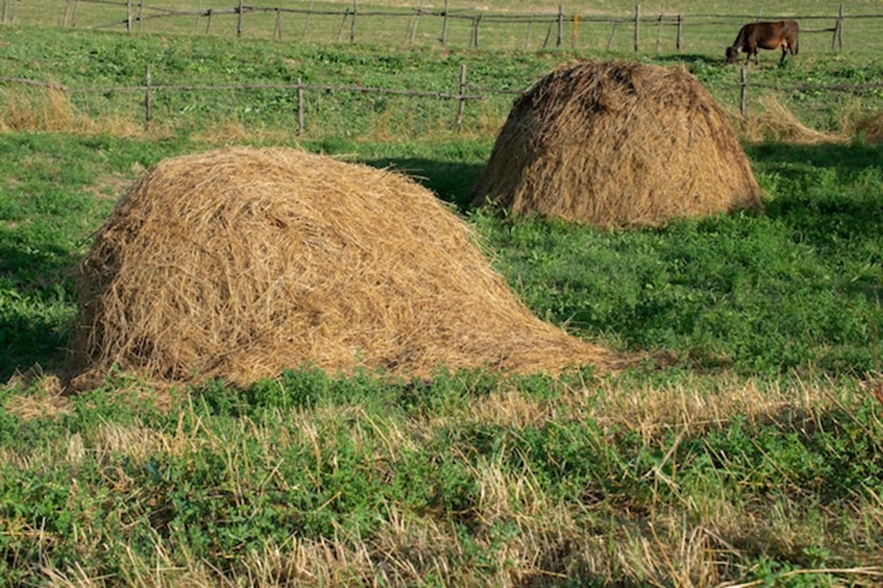
HAY

Slide 2
Definition of the hay:
It is the basic coarse materials (filler). resulting from preserving green fodder by drying, where the surplus fodder is transferred from the need of agricultural animals from agricultural lands and the largest area in it is 60% to a dry matter that becomes in the range of 15-20% . It is of high nutritional value that can be stored for the provision of animals in the seasons when we lack green fodder.

Slide 3
Importance of hay
* In feeding ruminants: hay is one of the most important filler feeds that enter the daily diet of animals. the nutritional value of the hay
varies depending on the plant from it.

Slide 4
* In general, hay contains a high percentage of materials and nutrients protein, sugars, mineral elements, vitamins, especially in the leaves of the plant, which contain most of the nutrients in the hay, the higher the quality becomes.
* Dried hay is a rich source of vitamins A,D and K, especially vitamins, riboflavin (b2), thiamine (b1), and folic acid, and mineral elements, especially calcium and phosphorous.

Slide 5
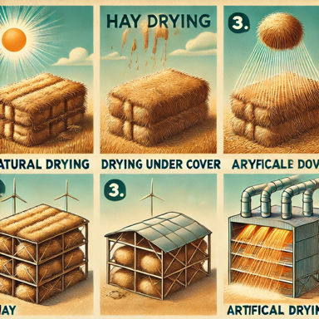
Methods of making hay:
hay can be manufactured in the following ways:
* Natural drying.
* Dry under the lid
* Artificial drying.

Slide 6
Factors that determine the quality of the hay:
1- Growth stage: The higher the stage of plant growth,
the greater the amount of dry matter produced in a dunum.
2- The color of the hay: related to (growth stage –
weather conditions drying and storage method).
3- Smell of hay: Good hay smells like green fodder, and bad hay smells like rotting or moldy hay.
4- Dependence on humidity: good hay has a humidity of 15-20%.

Slide 7
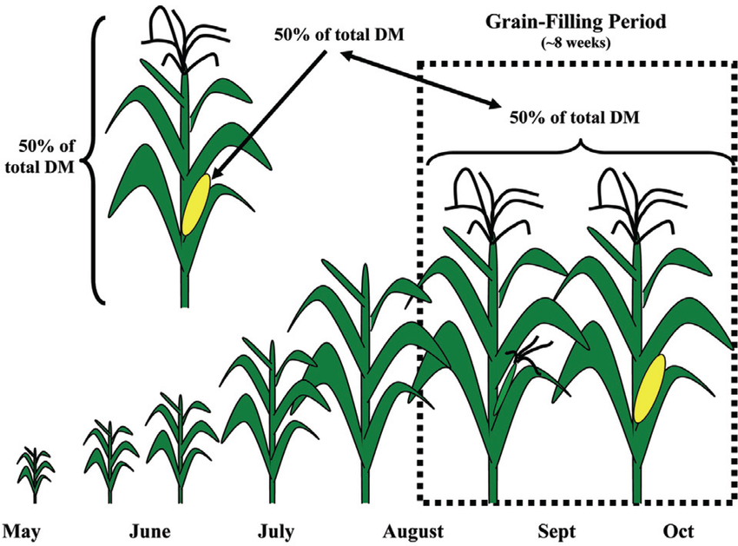

Slide 9
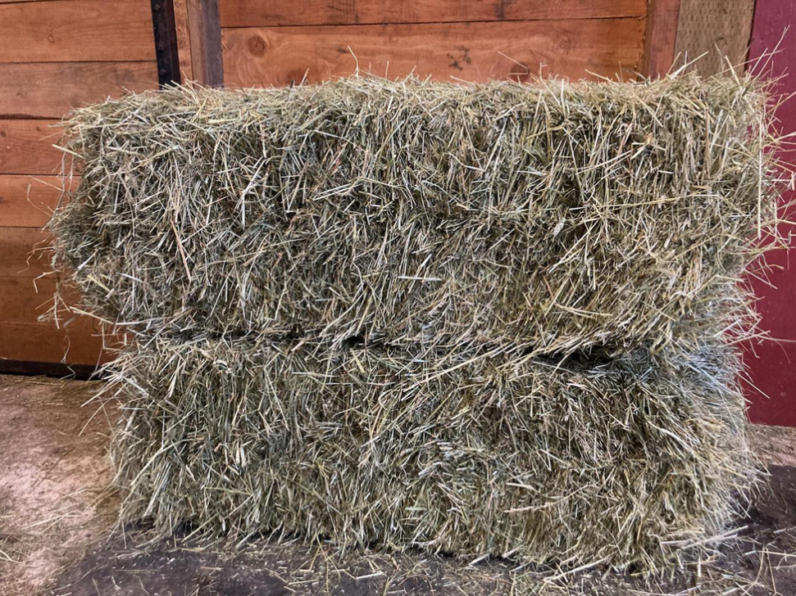
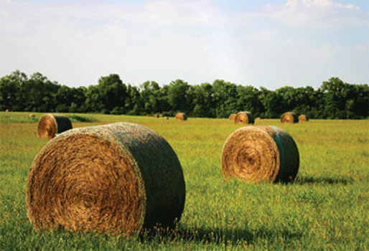
The quality of the hay is determined by the stage of plant growth and the color of the hay:

Slide 10
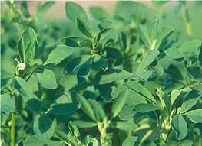
Types of feed that is made as a hay:
  Alfalfaالبرسيم
  It is grown in alfalfa cultivation areas. , and its productivity is 3-4 tons/ dunum. The percentage of protein in it is less, as the percentage of crude protein is 2.8% in the flowering stage and 10.8% in energy in green clover. and replace Alfalfa hay for the same purposes.

Slide 11
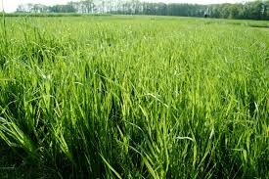
Grass crops محاصيل الحشائش: Most of the processed hay in the world, especially oats شوفان and barley الشعير, is grown in mixtures with leguminous crops المحاصيل البقولية to produce hay rich in both protein and energy.

Slide 12
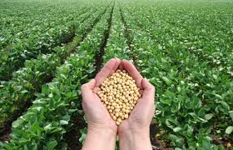
Soybeansفول الصويا Its length is 30-80 cm. Its varieties are divided into several groups (yellow-green - brown - black-mixture). Plant composition: Stem and branches make up 25.45% of the plant, leaves make up 40.17%, pods 34.37% there are varieties for green fodder, straw, grain, or oil.

Slide 13
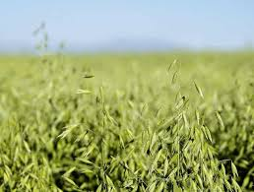
Oats الشوفان
: An annual plant of the grass crops is used as green fodder and hay for agricultural animals. Oat hay is low in protein. Its fodder value is good when it is grown as mixtures with leguminous crops as it leads to an increase in protein in the resulting hay. Early wetting in it leads to an increase in the proportion of energy and protein in it.

Slide 14
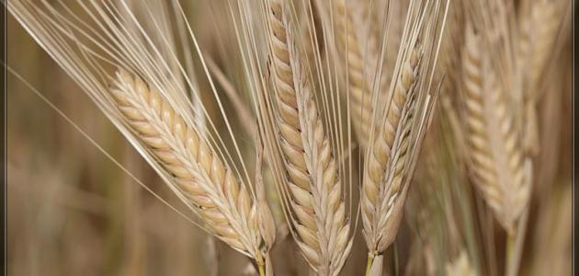
Barleyالشعير : It is usually grown in areas with low fertility and low humidity. The productivity of irrigated barley is 1.2-1.4 tons/dunam. Hay can be made from all barley varieties (six-row - two-row) and early weed for hay in early April at the beginning of flowering until the milky stage when good quality hay is produced. Its monster at the beginning of flowering gives hay the richest possible in energy and protein. The production of barley + vetch is equivalent to 30% of the production of a dunum of green fodder.

Slide 15
Herbs الاعشاب:There are many types of herbs that grow naturally or are cultivated to produce green matter in animal husbandry farms, including:
1- Grasses of the Grass family عشب عائلة الحشائش - :Muammar rye- جودار معمر - Sunsilah صنسيلة - Sibyla سبيلا - Wild barley شعير بري – Wheat قمح
All of these herbs can be made into good-quality hay as they are high in carbohydrates.
2- Herbs of the legume family عشب الفصيلة البقولية: : wild alfalfa- البرسيم البري wild galbanum الجلبانوم البري .

